Slide 1
Mobile App Development
Lecture 03

Slide 2
Flutter
Flutter is an open-source UI software development kit created by Google. It is used to develop applications for Android, iOS, Linux, Mac, Windows, Google Fuchsia, and the web from a single codebase. The first version of Flutter was known as codename "Sky" and ran on the Android operating system.

Slide 3
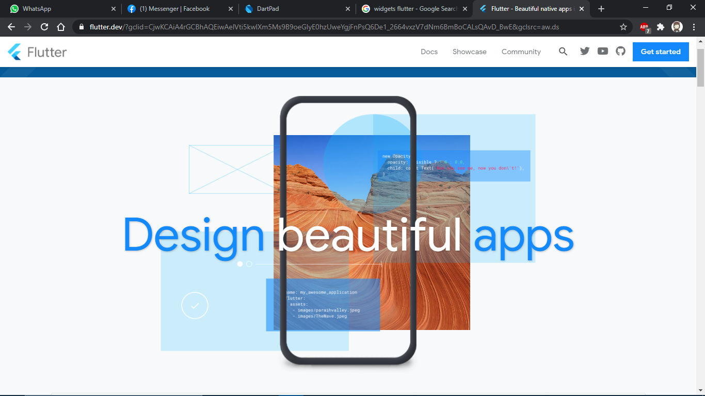
Why Flutter

Slide 4
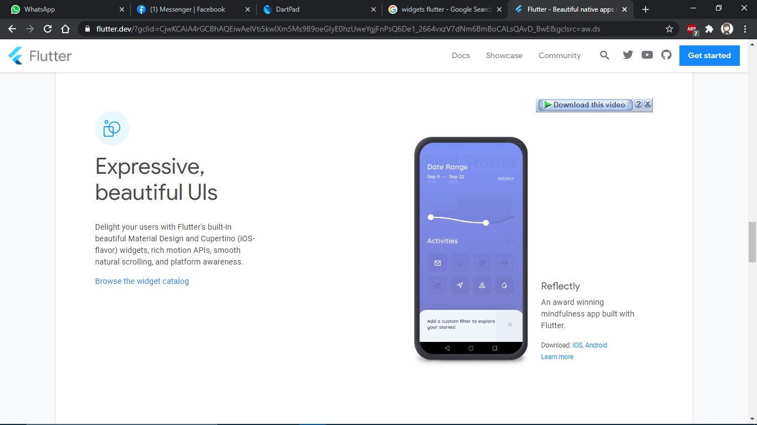

Slide 5
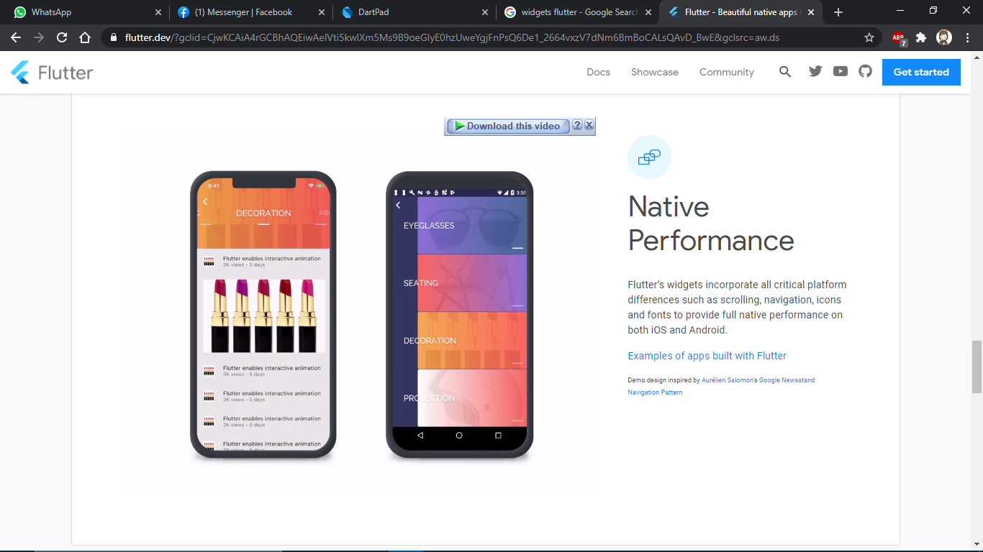

Slide 6
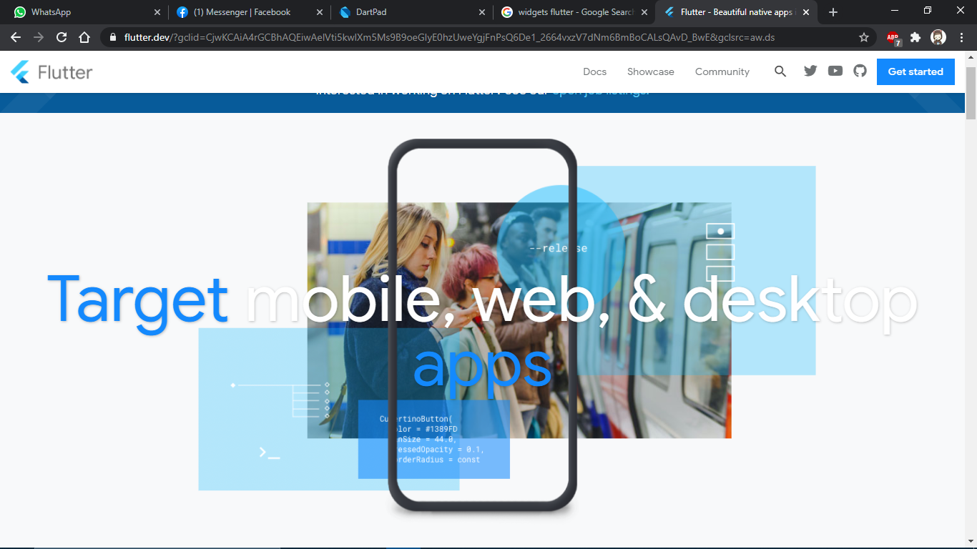

Slide 7
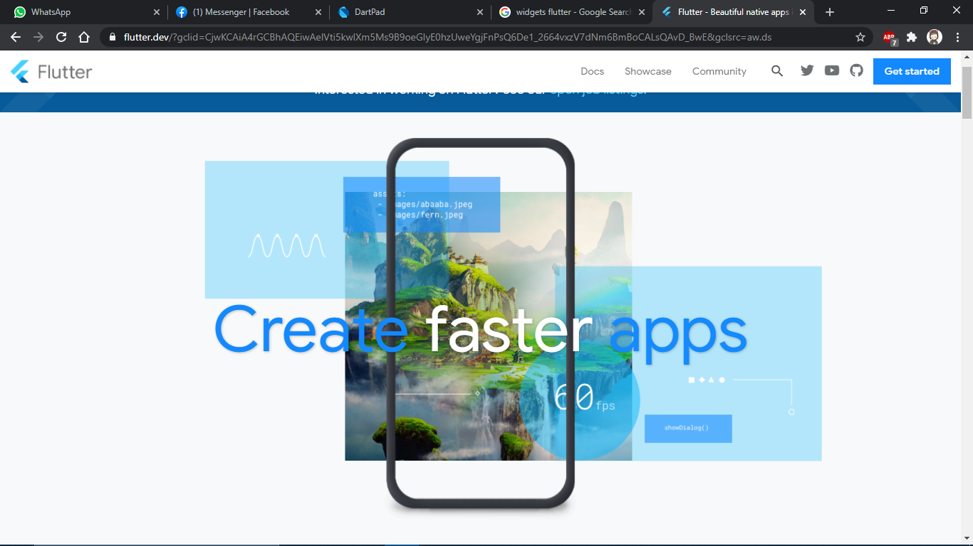

Slide 8
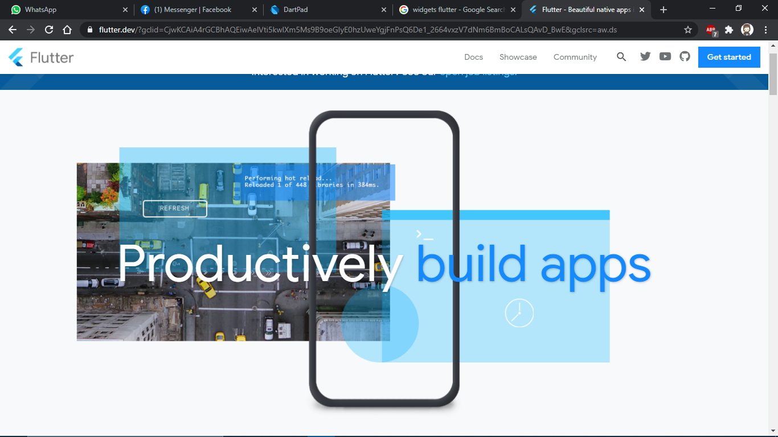

Slide 9
Flutter sdk
https://flutter.dev/

Slide 10
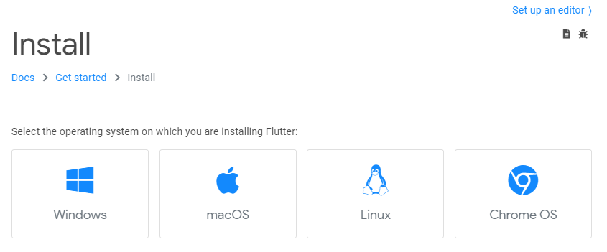
Flutter install

Slide 11
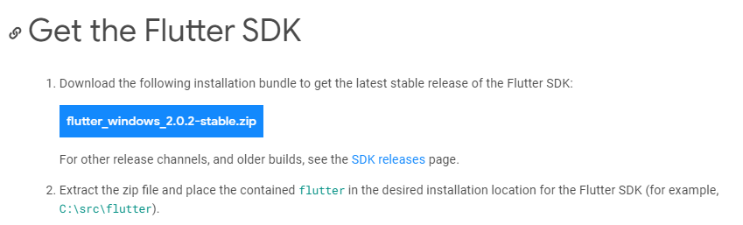

Slide 12
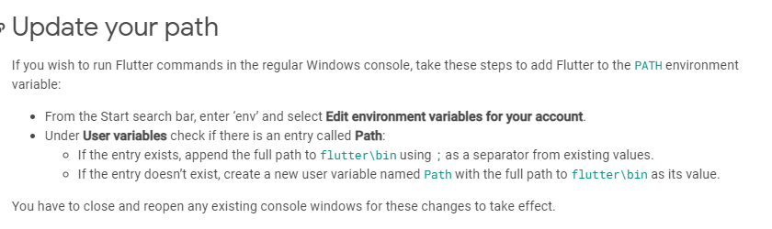

Slide 13
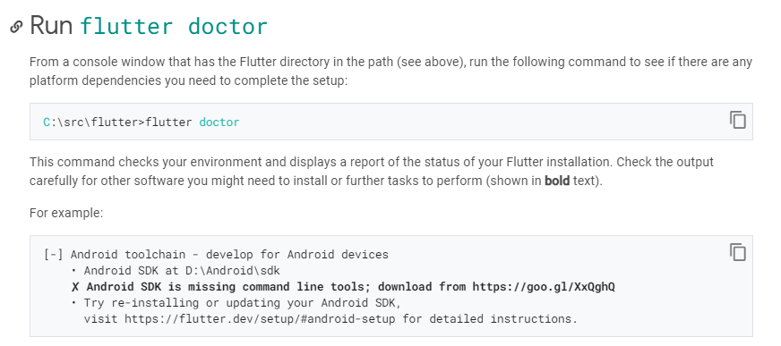

Slide 14
Android setup
Android Studio
https://developer.android.com/studio?gclid=CjwKCAiA4rGCBhAQEiwAelVtix_h7uInrlYjrvYjqMRTVRPwqzFhsEKxoSrhjBIiAXgGPBsmPwdfMRoCkIYQAvD_BwE&gclsrc=aw.ds

Slide 15
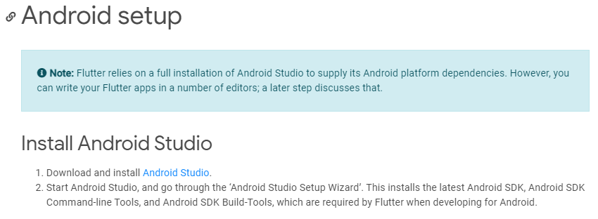

Slide 16
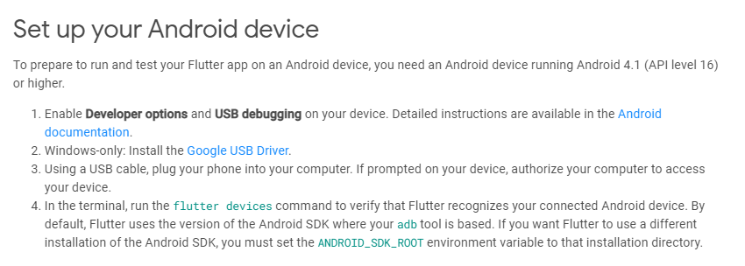

Slide 17
Android Emulator
Genymotion
https://www.genymotion.com/

Slide 18
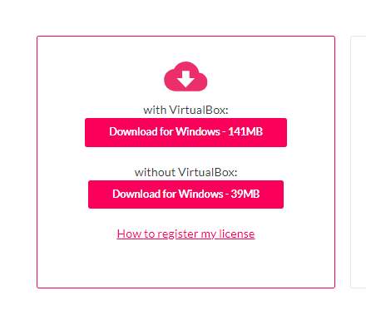
Genymotion

Slide 19
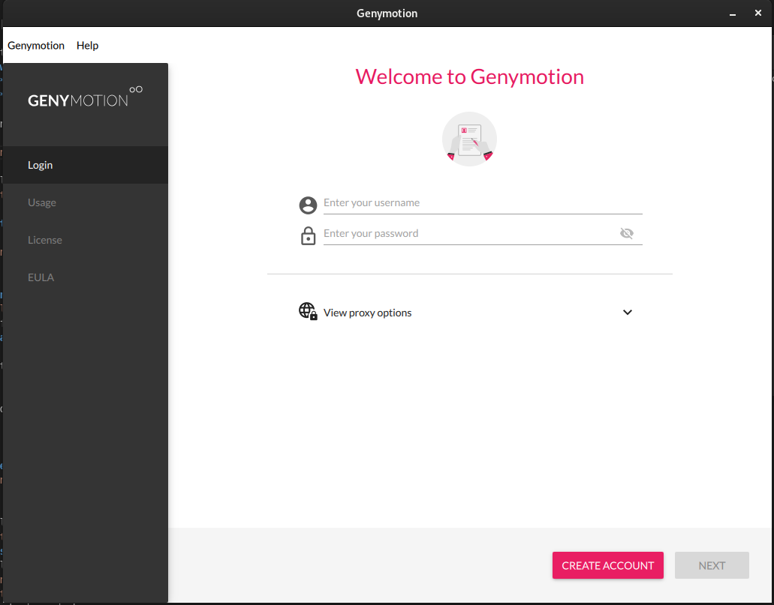
Create account

Slide 20
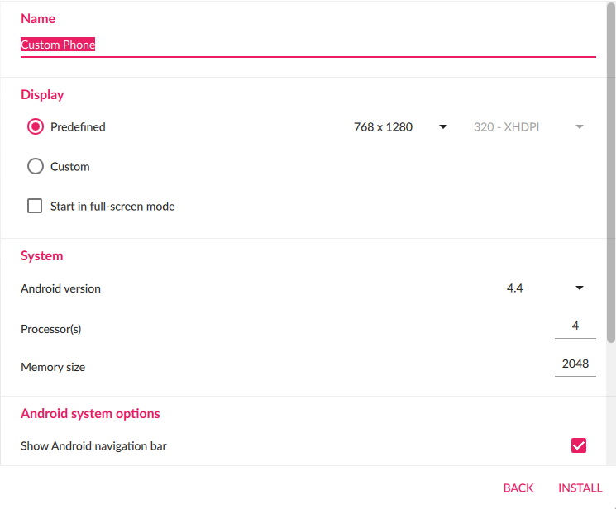
Create device

Slide 21
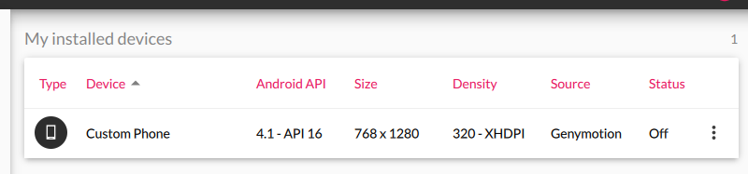
Start device

Slide 22
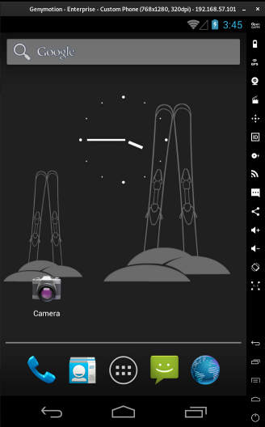
Your Android Device

